Slide 1
Gastrointestinal Disease Classification through Explainable and Cost-Sensitive Deep Neural Networks with Supervised Contrastive Learning
Dibya Nath , G. M. Shahariar
Ahsanullah University of Science and Technology
Paper ID- 307
Presenter
Dibya Nath

Slide 2
Content
Methodology
Experimental/Simulation Result
Conclusion
Future Research
References
Introduction
Problem Statement
Related Work
Research Questions
Objectives
Outcomes and Impacts

Slide 3
Introduction
Gastrointestinal diseases have a significant impact on health and well-being globally.
Traditional diagnostic procedures like endoscopy and colonoscopy have limitations in detecting anomalies accurately.
Proposed an approach involving an CNN architecture to aid gastrointestinal disease classification to help overcome the limitations.

Slide 4
Problem Statement
Assist decision-making medical personnel to provide right diagnosis in significantly less amount of time.
Present an optimal pre-trained CNNs architecture to enhance detection and classification accuracy of gastrointestinal diseases.
Incorporate explainable AI techniques to improve interpretability to gain insights into disease classification decisions.

Slide 5
Related Work
Jha et al. [1] evaluated several state-of-the-art methods on Kvasir-SEG dataset for the polyp detection and localization. Their retrospective design lacked real-world validation through clinical studies. Resized images also might compromise algorithm performance due to possible information loss.
Khan et al. [2] fine-tuned Inception-v3, DenseNet201 and AlexNet, and transformed them into SecureCNN models for feature extraction from the images and feature optimization of the network for detection . Their chosen three classes of the dataset are ulcer, bleeding, and healthy which indicates the distinct lack of varied types.

Slide 6
Related Work
Shin et al. [4] employed polyp-frame datasets nd two colonoscopy video databases to apply a region-based CNN model,with the purpose of identifying polyps automatically in colonoscopy images and videos.
Ribeiro et al. [5] pursued a binary classification task employing various CNNs and employing a transfer learning approach, they evaluated different CNN architectures for polyps detection wherein ResNet-152 showcased exceptional performance. However, both ResNet-50 and ResNet-152 occasionally misidentified normal intestinal structures as polyps due to their distinctive volumes.

Slide 7
Research Questions
How can the integration of pre-trained CNN architectures enhance the diagnostic accuracy of gastrointestinal diseases?
How can the transparency of disease detection processes using machine learning be enhanced to enable informed medical assessments?

Slide 8
Objectives
Classify gastrointestinal diseases to increase detection accuracy and decrease decision-making time.
Demonstrate the performance of different pre-trained CNN models.
Incorporate XAI to ensure transparency and interpretability, fostering informed medical assessment.

Slide 9
Outcomes and Impacts
Outcome:
Increased accuracy and transparency in disease detection
Impact:
Enabling healthcare personnel to gain deeper insights into diagnostic outcomes.

Slide 10
Methodology

Slide 11
Methodology (Cont.)
Data augmentation: Implement random cropping, flipping, color dropping, color jittering to enhance the variability in the training dataset
Image processing: Standardize the dimensions of all the images by resizing them to a resolution of 224 × 224
Contrastive training: Fine-tune a pre-trained Xception CNN base encoder with MaxMargin contrastive loss, incorporating a projection head to minimize intra-class image distances and maximize inter-class distances.

Slide 12
Methodology (Cont.)
Classifier with frozen encoder: Build a frozen image encoder, a classifier with cross-entropy training and fine-tune (a) without cost-sensitive learning (b) with cost-sensitive learning with automatic class weight computation using sklearn.
Interpretation using XAI: Employ GradCAM, GradCAM++, faster version of Score-CAM, and LayerCAM, to visually depict the classifier's prediction outcomes.

Slide 13
Experimental Result
Training Objective | Model | Test Accuracy | MaxMargin Loss | Weighted avg F1-score
Constrastive Learning | EfficientNetB0 | 63.61 | 0.045 | 0.56
 | EfficientNetB1 | 54.899 | 0.055 | 0.47
 | EfficientNetB2 | 60.196 | 0.056 | 0.50
 | EfficientNetV2B0 | 71.96 | 0.0335 | 0.66
 | EfficientNetV2B1 | 69.432 | 0.03 | 0.62
 | EfficientNetV2B2 | 68.21 | 0.047 | 0.61
 | ResNet50 | 79.18 | 0.024 | 0.76
 | DenseNet121 | 79.6 | 0.335 | 0.75
 | DenseNet169 | 82.46 | 0.026 | 0.83
 | Inception V3 | 76.27 | 0.027 | 0.07
 | Xception | 83.544 | 0.027 | 0.81
Constrastive Learning + Cost-Sensitive | Xception | 88.74 | 0.027 | 0.86
 | ResNet50 EfficientNetB7 [6] | 88.18
 | EfficientNet (teacher student framework) [7] | 84 |  | 0.84

Slide 14
Experimental Results
 | Without Cost-Sensitive |  |  | With Cost-Sensitive
Class Name | Precision | Recall | F1- Score | Precision | Recall | F1- Score
cecum | 0.94 | 0.99 | 0.96 | 0.95 | 1.00 | 0.97
ileum | 0.00 | 0.00 | 0.00 | 0.00 | 0.00 | 0.00
retroflex rectum | 0.91 | 0.91 | 0.91 | 0.91 | 0.99 | 0.94
hemorrhoids | 0.00 | 0.00 | 0.00 | 0.00 | 0.00 | 0.00
polyps | 0.96 | 0.99 | 0.98 | 0.99 | 1.00 | 0.99
ulcerative colitis grade_0_1 | 0.00 | 0.00 | 0.00 | 0.00 | 0.00 | 0.00
ulcerative colitis grade_1 | 0.00 | 0.00 | 0.00 | 0.00 | 0.00 | 0.00
ulcerative colitis grade_1_2 | 0.00 | 0.00 | 0.00 | 0.00 | 0.00 | 0.00
ulcerative colitis grade_2 | 0.52 | 0.76 | 0.62 | 0.56 | 0.94 | 0.70
ulcerative colitis grade_2_3 | 0.00 | 0.00 | 0.00 | 0.00 | 0.00 | 0.00
ulcerative colitis grade_3 | 0.00 | 0.00 | 0.00 | 0.00 | 0.00 | 0.00
bbps_0_1 | 0.94 | 0.96 | 0.95 | 0.96 | 0.98 | 0.97
bbps_2_3 | 0.98 | 0.99 | 0.98 | 1.00 | 1.00 | 1.00
impacted_stool | 0.94 | 0.71 | 0.81 | 1.00 | 0.85 | 0.92
dyed_lifted_polyps | 0.80 | 0.83 | 0.81 | 0.95 | 0.93 | 0.94
dyed_resection_margins | 0.83 | 0.81 | 0.82 | 0.94 | 0.96 | 0.95
pylorus | 0.87 | 0.88 | 0.92 | 0.93 | 1.00 | 0.97
retroflex_stomach | 0.95 | 0.99 | 0.97 | 0.99 | 0.99 | 0.99
z_line | 0.96 | 0.85 | 0.75 | 0.71 | 0.95 | 0.81
barretts | 0.00 | 0.00 | 0.00 | 0.00 | 0.00 | 0.00
barretts_short_segment | 0.00 | 0.00 | 0.00 | 0.00 | 0.00 | 0.00
esophagitis_a | 0.33 | 0.22 | 0.26 | 0.55 | 0.21 | 0.30
esophagitis_b_d | 0.45 | 0.23 | 0.31 | 0.54 | 0.52 | 0.53
Macro avg | 0.48 | 0.49 | 0.48 | 0.52 | 0.53 | 0.52
Weighted avg | 0.80 | 0.84 | 0.81 | 0.85 | 0.89 | 0.86

Slide 15
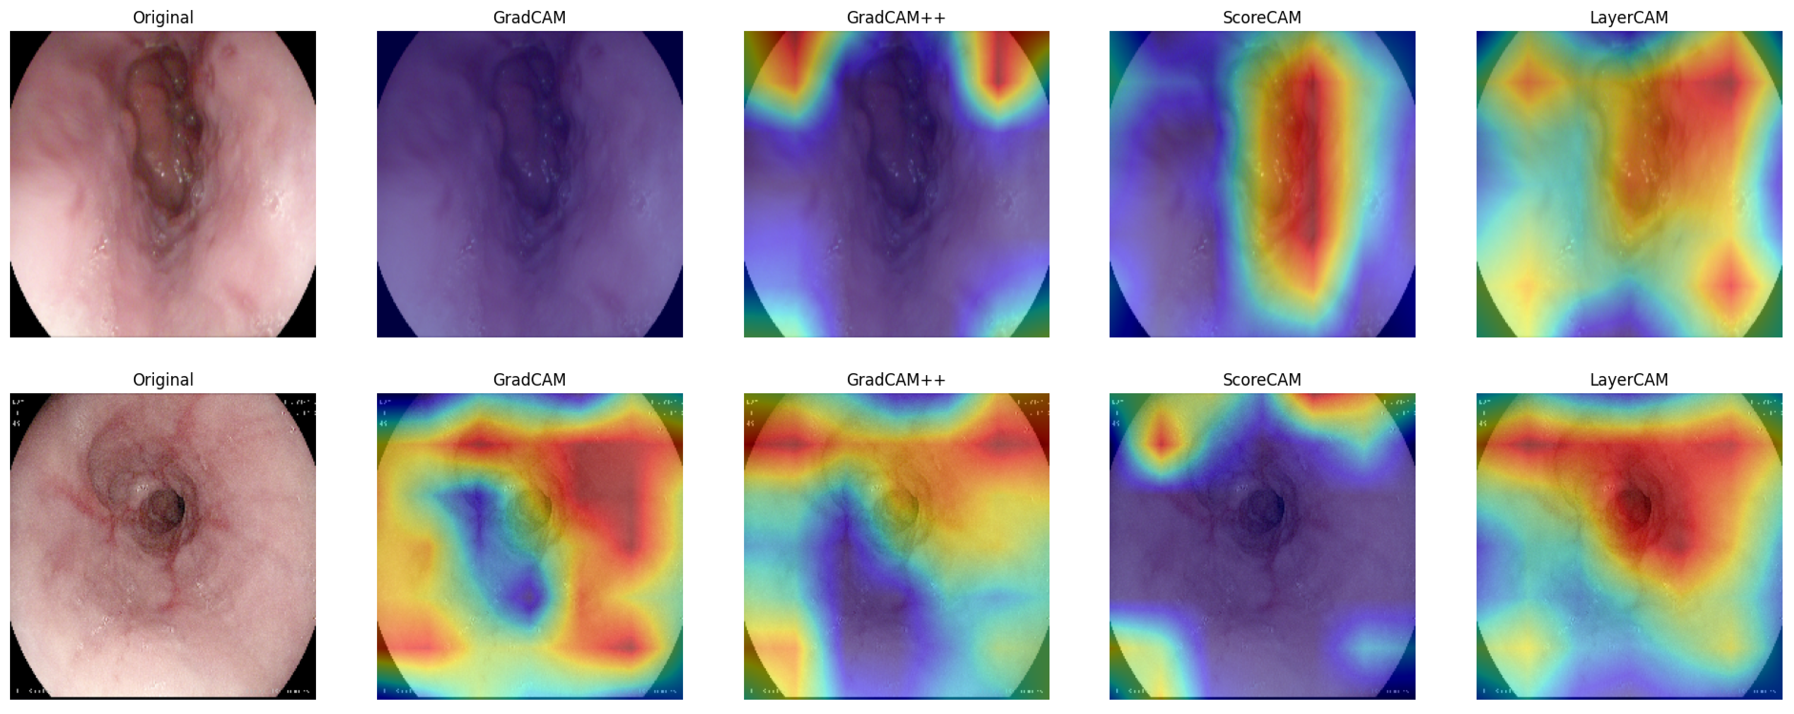
Simulation Results
Two sample outputs of correctly classified instances by Xception with cost-sensitive learning using XAI techniques

Slide 16
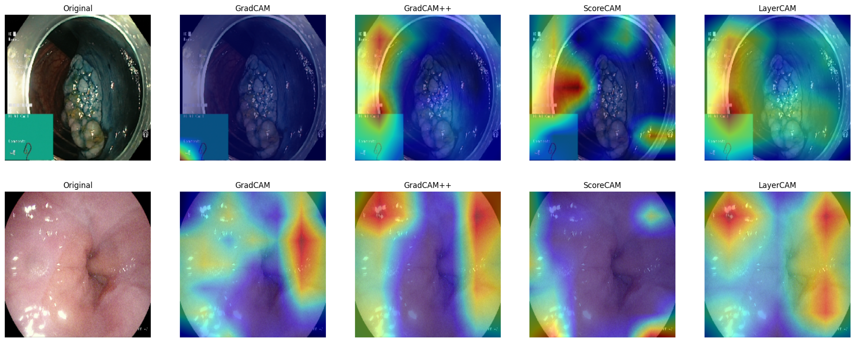
Simulation Results (Cont.)
Two sample outputs of misclassified instances by Xception with cost-sensitive learning using XAI techniques

Slide 17
Conclusion
The study aimed to-
Classify gastrointestinal diseases using pre-trained CNN models, enhancing accuracy with supervised contrastive then cost-sensitive learning
Implement XAI techniques to shed light on the CNN models' decision-making processes

Slide 18
Future Research Direction
Future research directions encompass-
Multi-modal integration
Transferability to diverse disease domains
Incremental learning
Ensemble methods
Disease tracking for personalized treatment planning

Slide 19
Reference
[1] Jha, D., Ali, S., Tomar, N.K., Johansen, H.D., Johansen, D., Rittscher, J., Riegler, M.A., Halvorsen, P.: Real-time polyp detection, localization and segmentation in colonoscopy using deep learning. Ieee Access 9, 40496–40510 (2021)
[2] Khan, M.A., Nasir, I.M., Sharif, M., Alhaisoni, M., Kadry, S., Bukhari, S.A.C., Nam, Y.: A blockchain based framework for stomach abnormalities recognition. Computers, Materials & Continua 67(1), 141–158 (2021)
[3] Sun, M., Liang, K., Zhang, W., Chang, Q., Zhou, X.: Non-local attention and densely-connected convolutional neural networks for malignancy suspiciousness classification of gastric ulcer. IEEE Access 8, 15812–15822 (2020)
[4] Shin, Y., Qadir, H.A., Aabakken, L., Bergsland, J., Balasingham, I.: Automatic colon polyp detection using region based deep cnn and post learning approaches. IEEE Access 6, 40950–40962 (2018)
[5] Ribeiro, J., N ́obrega, S., Cunha, A.: Polyps detection in colonoscopies. Procedia Computer Science 196, 477–484 (2022)

Slide 20
Reference
[6] Gupta, D., Anand, G., Kirar, P., Meel, P.: Classification of endoscopic images and identification of gastrointestinal diseases. In: 2022 International Conference on Machine Learning, Big Data, Cloud and Parallel Computing (COM-IT-CON). vol. 1, pp. 231–235 (2022)
[7] Gjestang, H.L., Hicks, S.A., Thambawita, V., Halvorsen, P., Riegler, M.A.: A self-learning teacher-student framework for gastrointestinal image classification. In: 2021 IEEE 34th International Symposium on Computer-Based Medical Systems (CBMS). pp. 539–544 (2021)

